Slide 1
Lecture 4
Digital Electronics
ECE 213
Anil Kumar Rawat
Assistant Professor

Slide 2
Binary code for Decimal number
Binary code are appropriate for internal computation of a digital system
People prefer to deal with decimal number
External interface of a digital system accepts/process/displays decimal number directly
Binary code for decimal digit requires minimum four bits.
Different code can obtain by arranging four or more bit
Binary Code
Weighted Code
Non Weighted Code
each position of the number represents a specific weight
Binary Code, Octal Code, Decimal Code, Hexadecimal code,
Binary Coded Decimal (BCD) Code
each position within the binary number is not assigned a fixed value
Excess3 code, Gray code

Slide 3
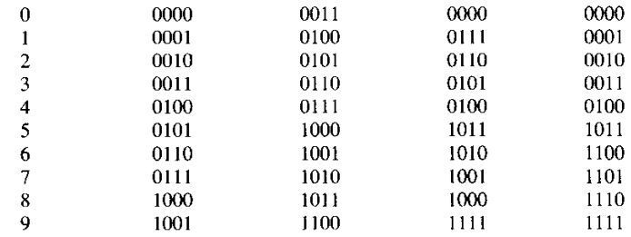
Set of n-bit string represent a number called code
A particular combination of n-bit value is codeword
BCD (Binary coded Decimal) is straight assignment of binary equivalent
BCD code ranges from 0-9
Excess-3 code is self complimentary code
it can easily be complemented(9's complement) to perform addition in the case of subtraction.
so switching activity between different number system reduces due to which power consumption becomes less and speed can increase and this leads to hardware simplification.
Decimal Digit | BCD Code 8 4 2 1 | Excess-3 | 8 4 -2 -1 | 2 4 2 1

Slide 4
POLL 1
BCD equivalent of decimal no. 17 is
00010001
00010111
00010110
00010011

Slide 5
Poll 2
Excess 3 equivalent of BCD number 0011 is
0110
0111
1001
0100

Slide 6
Poll 3
Which of the following is example of non weighted code?
Binary
Decimal
Excess 3 Code
Octal

Slide 7
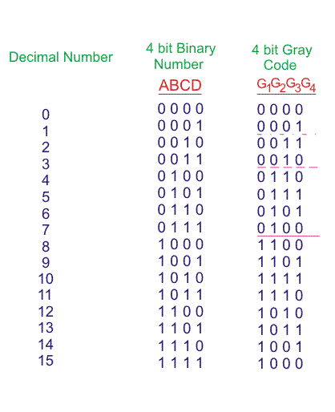
Gray codes

Slide 8
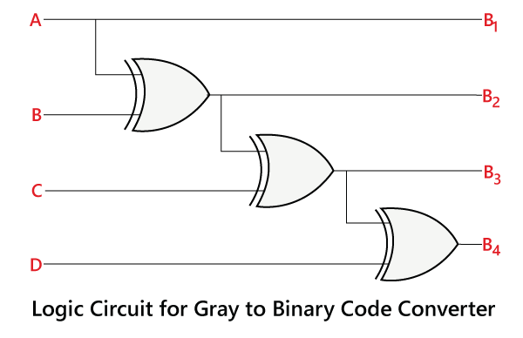
Gray to Binary Code

Slide 9
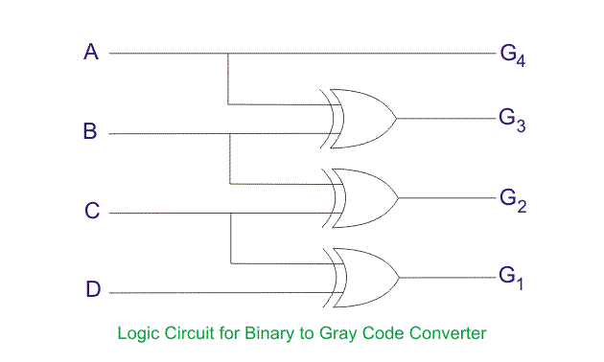
Binary to Gray Code

